Slide 1
The Process of Communication and it`s Barriers
A scientific model

Slide 2
Activity
The following slide lists the elements involved in the process of communication. In what order will they appear in any single act of communication.

Slide 3
The Elements
Decoding
Sender
Feedback
Receiver
Message
Encoding
Channel

Slide 4
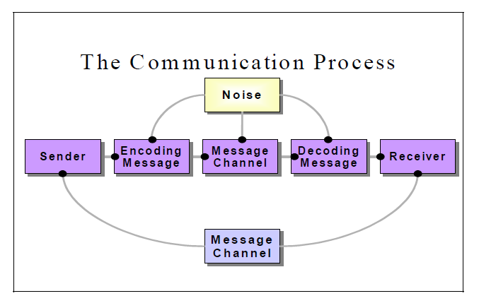
The process of Communication

Slide 5
Lets Study the Elements in Detail

Slide 6
1. SENDER
The person/entity who sends messages.
Senders have a background of accumulated attitudes, experiences, skills, cultural conditioning, and individual differences that influences how they communicate.

Slide 7
MESSAGE
It is the idea or feeling that the sender wants to communicate.

Slide 8
OBJECTIVE OF COMMUNICATION
All communication is motivated and initiated by clear objectives which can be
  information
  education
  persuasion
  motivation
  instruction
  raising morale
  advice and so on

Slide 9
ENCODING
Encoding is the process where the information you would like to communicate gets transferred into a form (words or signs) to be sent and decoded by the receiver.
Encoding is a complex activity.
Encoding must happen after considering the objective of communication, the receivers, the channel and the context.

Slide 10


Slide 11
Activity
ABS Corp is an organization that has been around for ten years. It has revised its Medical Leave Policy. The allowable medical leaves have been cut down from 10 to 5 days. This message has to be delivered to the employees ASAP. How will they compose the message?
What factors will be considered while formulating the message.

Slide 12
CHANNEL
The channel is the means or technique used to convey the message, like, a conversation, telephone call, radio, television program, etc.

Slide 13
THE RECEIVER
The receiver is the target recipient of the message.
It is important to understand that receivers have to engage in a whole process to receive messages.
Receivers decode messages after active listening.

Slide 14
THE RECEIVER
Receivers decode or interpret messages under the influence of
    Self Concept
    Presuppositions
    Experience
    Expectations
    Attitudes and values
    Cultural, social, religious, and educational background
    Feelings
    Intellectual level, age

Slide 15
FEEDBACK
Feedback is the main component of communication process as it permits the sender to analyze the efficacy of the message. It helps the sender in confirming the correct interpretation of message by the decoder. Feedback may be verbal (through words) or non-verbal (in form of smiles, sighs, etc.). It may take written form also in form of memos, reports, etc.

Slide 16
FEEDBACK
Feedback is important as it
  Provides continuity in communication
  Indicates effective understanding or misunderstanding of the message
  Stimulates further communication and adds discussion
  Can sometimes hinder communication

Slide 17
FEEDBACK
It can be both constructive or destructive in business settings.
How should a manager respond to a poorly written proposal by an employee?

Slide 18
CONTEXT
Context is the situation or setting within which communication takes place. It plays an extremely important part in how a message is encoded and decoded.

Slide 19
Activity
If the employees of ABS Corp are unhappy with the new Medical Leave Policy, how should they voice their opinion?

Slide 20
Barriers to Communication
Barriers can occur at any stage of the communication process and block, distort, or interrupt it.
Sources of barriers can lie in Senders, Receivers, or Channels

Slide 21
Sender related factors that cause Communication barriers
Ineffective encoding, like, inappropriate choice of words
Violation of 7Cs
Inappropriate channel selection
Ineffective audience analysis
Information overload
Language proficiency

Slide 22
Receiver related factors that cause Communication barriers
Different world views and ideologies
Distractions: physical and emotional
Language proficiency
Inaccurate interpretation
Selective Perception
Inadequate feedback

Slide 23
Channel related factors that cause Communication barriers
Noise
Interruptions, interference,
Distractions
eg, failure of technology in case of emails, projectors, etc

Slide 24
Activity
Nesta is a business corporation. It is facing issues like unsatisfactory employee productivity, unhealthy interpersonal relationships between the employees, lack of creativity.
How can communication be used to resolve the above problems.

Slide 25
Overcoming Barriers
For the sender
Be clear about the message to be sent.
Be precise and to the point
Use a language understandable to the receiver.
Request a feedback to ensure receipt of message
For the receiver
Listen Actively.
Concentrate on the message
Ask for clarifications wherever required.
Understand the body language.
Make notes if required.

Slide 26
Task from the handout.
Homework.
Complete the following task from the handout.
How can the knowledge of the process of communication enable a person to communicate more effectively?

